Slide 1
ALGEBRA 4
Day 51

Slide 2
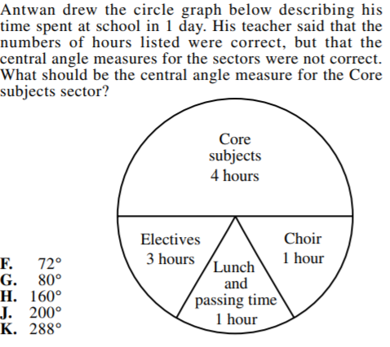
Bell Work

Slide 3
Finish Unit 5 Quiz 2
You can use your notes (as always on a quiz)
You’ll want a calculator to help you find zeros.

Slide 4
Things to Study
Identify Standard Form, Degree, Lead Coefficient, Constant. Etc
Factor (use zeros from graph if necessary)
Write Equation given zeros
Find zeros (from graph and/or with division)
Divide polynomials

Slide 5
Review Assignment
Select the problems that you need the most work on… or we can do some as a class
Page 348 #5-29, 35-37, 44-47, 52-53, 60-67
Your other option is to work problems from missing assignments

